Slide 1







Application Submission System &
Interface for Submission Tracking
A
S
T
S
I
S
Sheri Cummins
June 2014

Slide 2

Why a New System?

Slide 3

Unfortunately…
The structure of NIH’s multi-project applications cannot be accommodated by Grants.gov’s downloadable forms.

Slide 4

Our Approach
We partnered with the Grants.gov team so NIH could develop ASSIST, a web-based submission system to accept NIH’s multi-project applications that works in conjunction with Grants.gov.

Slide 5
The result
Essentially, ASSIST works as an alternate web front end to Grants.gov’s “Apply” for NIH’s multi-project applications, much like a system-to-system service provider might.
This approach allows system-to-system submitters to continue to send their submission through Grants.gov without using ASSIST.

Slide 6

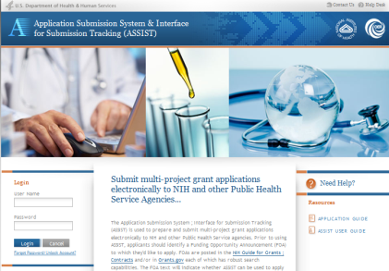




Behind the scenes…

Slide 7

Electronic Submission Required!
ASSIST has allowed NIH to reach its goal of accepting all competing grant applications electronically!

Slide 8
Electronic Submission of Multi-Project Applications Using ASSIST

Slide 9

Registration - Preparing Application
All ASSIST users must have eRA Commons credentials
  Accounts with the following eRA Commons roles are currently recognized by ASSIST:
    Signing Official (SO)
    Administrative Official (AO)
    Principal Investigator (PI)
    Assistant (ASST)
    Account Administrator (AA)
  As of July 18, 2014, ASSIST will recognize accounts with any role

Slide 10
Registration – Submitting Application
To submit your application using ASSIST you will need:
  an eRA Commons account with the Signing Official (SO) role
AND
  an active Grants.gov Authorized Organization Representative (AOR) account

Slide 11

Account Notes
Work within eRA Commons and Grants.gov to establish your accounts and be sure you can log in to those systems before using your accounts with ASSIST
If you run into password or other account issues, return to eRA Commons or Grants.gov to work through those
issues

Slide 12








Overview of Process
Find
Opportunity
Enter application data for all components
Initiate application and create the application shell
Submit your application through Grants.gov to NIH
Find
Plan
Initiate
Build Team
Enter Data
Finalize
Submit
Track
Get familiar
with the process and create an application plan
Finalize
components and prepare your application for submission
Define your team and provide application access
Track status and view final application image

Slide 13
Find Opportunity
Find
Plan
Initiate
Build Team
Enter Data
Finalize
Submit
Track

Slide 14

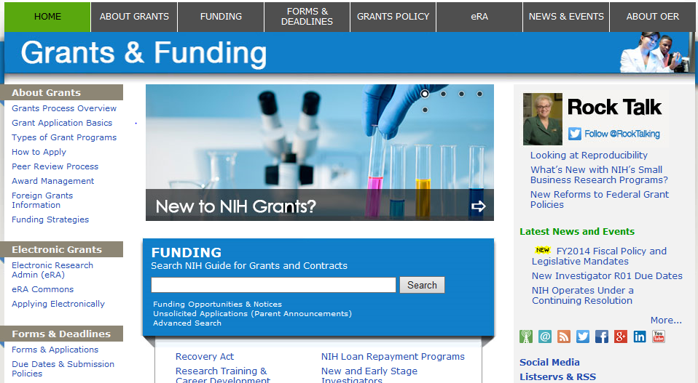
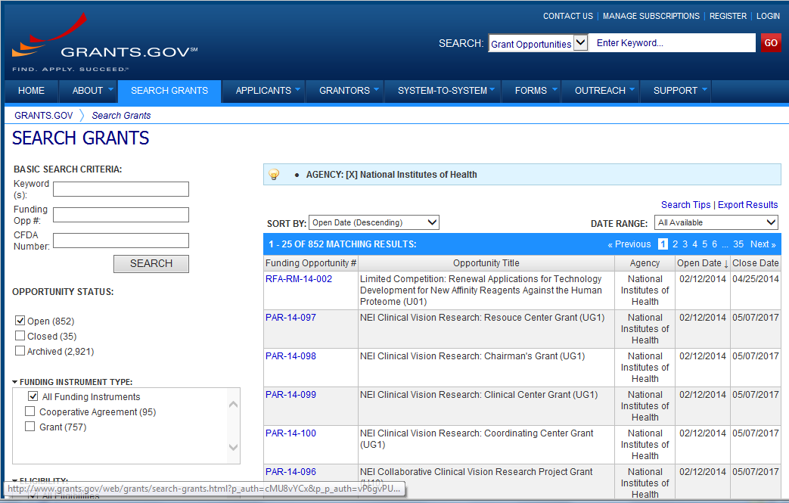
Find Multi-project FOAs in…
NIH Guide for Grants & Contracts
Grants.gov Search Grants

Slide 15
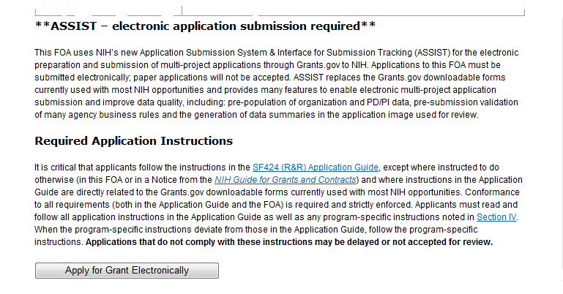
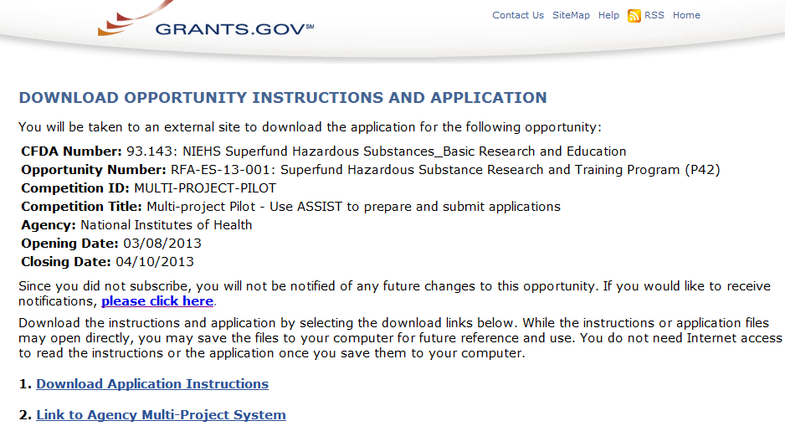
FOAs Link You to ASSIST
NIH Guide for Grants & Contracts
Grants.gov ‘Apply’

Slide 16

Before jumping into ASSIST, take some time to learn about the new process

Slide 17
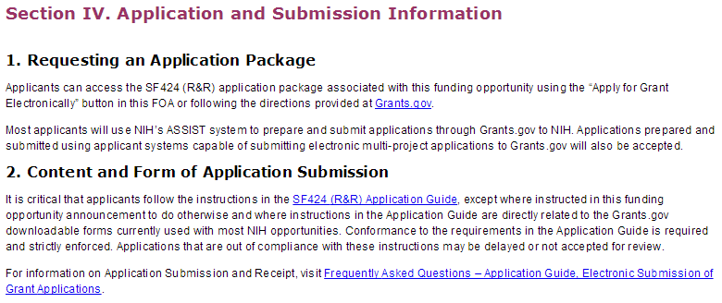
Multi-project FOAs
Section IV. Application and Submission Information of NIH FOAs includes important guidance for preparing your application in ASSIST.
The SF424 (R&R) Application Guide provides general instructions for completing application forms.

Slide 18

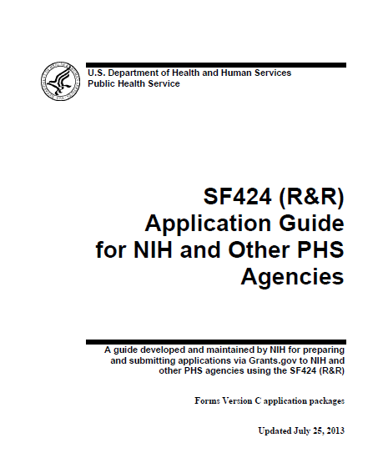
Application Guide
Agency-specific
instructions are
marked with the HHS logo.
Pay special attention to Section 9 - Instructions for Preparing a Multi-Project Application.
Refer to Supplemental Grant Instructions as needed (human subjects, policies, assurances, definitions and more).

Slide 19
New Application Format
All electronic multi-project applications will include:
  A single Overall component
    Provides overview of entire application
  Some number of additional components
    Component types allowed will vary by opportunity
    Announcements will clearly indicate the types of components expected in a responsive application
  Automatically prepared data summaries
    Compiled from information included in components
    Helps reviewers and staff work with the applications

Slide 20

Multi-project Application Assembly
Understand how your application image will be assembled by NIH
  The Overall component is presented first
    Including system-generated data summaries
  Additional component types are presented in alphabetical order (e.g., Cores before Projects)
    Components of the same type are grouped together
    Components are identified by type and sequential number (e.g., Core-001, Core-002)
Check out this resource: http://grants.nih.gov/grants/ElectronicReceipt/files/multi-project_application_image.pdf

Slide 21

Create an Application Plan
Find
Plan
Initiate
Build Team
Enter Data
Finalize
Submit
Track

Slide 22
Create an Application Plan
Carefully read the FOA and note the allowable types of required/optional components and any special instructions
Decide how to distribute the work
Ensure all eRA Commons and Grants.gov registrations are in place
  Gather the Commons IDs for everyone who will be working on your application in ASSIST

Slide 23
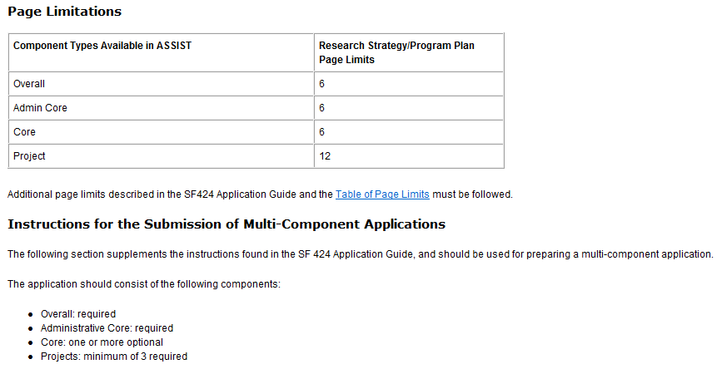
FOA Text Instructions
Sample excerpt from FOA (section IV)

Slide 24
Define the Layout of Your Application
Think about the components you plan to include
  PD/PI(s) for entire application
  Organization lead for each component
  Project lead for each component
  Project Title for application/components
  Start/End dates for application/components

Slide 25

Create an Application Shell
Create an application shell by initiating the application and adding the components in the order you would like them to appear
  As of April 25, 2014, applicants can rearrange components of the same type (e.g., have the third project entered in ASSIST appear first in the assembled application image)
  Components can be added or abandoned at any time

Slide 26







Sample Application Layout
Overall Component
PD/PIs: Cher D. Money, Ben A. Round
Organization: A
Project Title: Research Center to Cure the Diseases of the World
Component Type: Admin Core
Component Type: Core
Component Type: Project
Admin Core-001
Core-001
Project-001
Project Title: Administrative Core
Project Lead: Jed I. Knight
Organization: A
Project Title: Research Core
Project Lead: Ben A. Round
Organization: A
Project Title: Fabulous Research Focus 1
Project Lead: Cher D. Money
Organization: A
Subaward Budget
Project-002
Organization: D
Project Title: Fabulous Research Focus 2
Project Lead: Quin T. Sential
Organization: B
Core-002
Project Title: Communications Core
Project Lead: Abel Tu Lead
Organization: B
Project-003
Project Title: Fabulous Research Focus 3
Project Lead: Ima Doer
Organization: C

Slide 27

Initiate Your Application and Create an Application Shell
Find
Plan
Initiate
Build Team
Enter Data
Finalize
Submit
Track

Slide 28

Log In to ASSIST
https://public.era.nih.gov/assist
Use your eRA Commons credentials to access ASSIST.

Slide 29
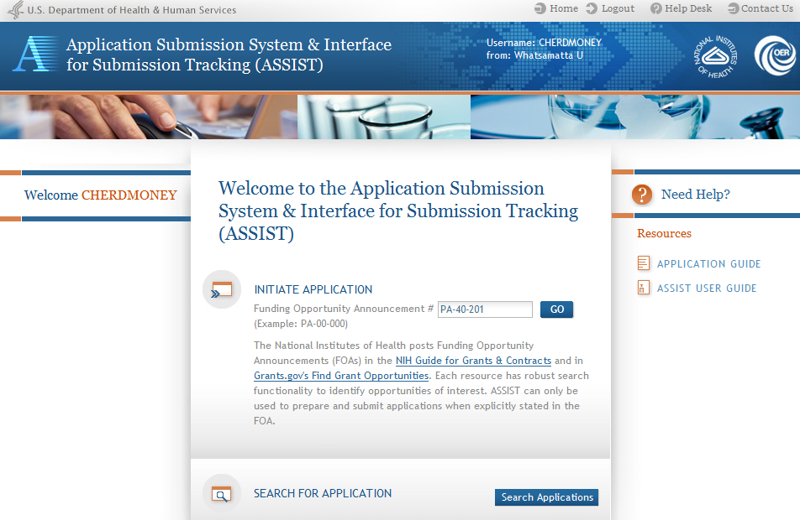
Initiate Application

Slide 30
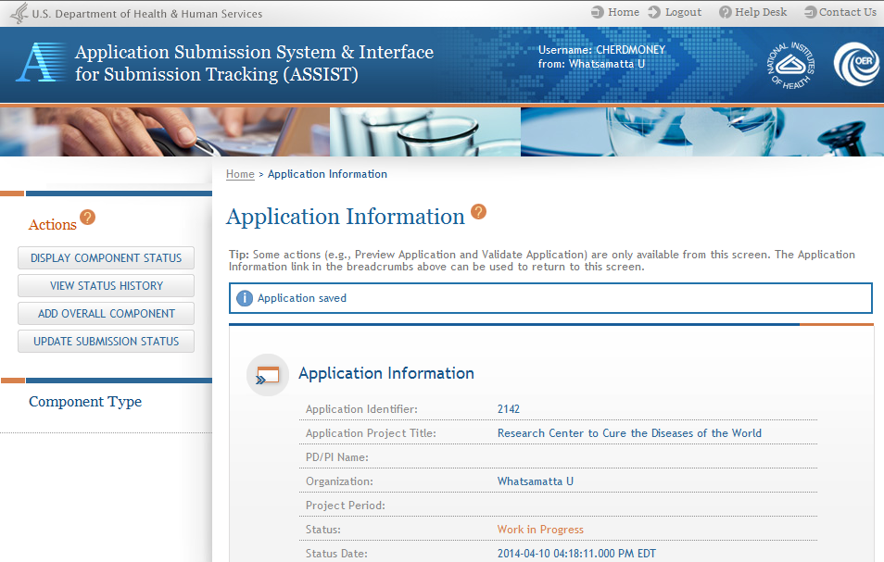
Using ASSIST
Click on question mark icon to access ASSIST help.
ASSIST messages appear at top of screen.
Available actions vary based on application context and access.

Slide 31
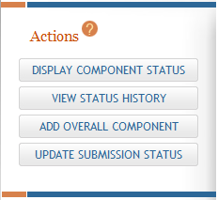
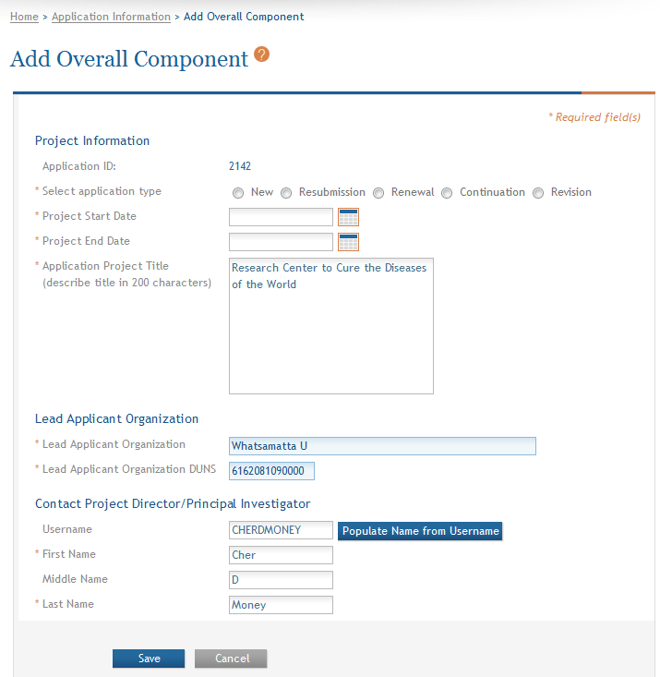
Add Overall Component
Click Add Overall Component to start building your application.
Enter the Commons Username for the contact PD/PI and use the Populate Name from Username button or type PD/PI name.

Slide 32
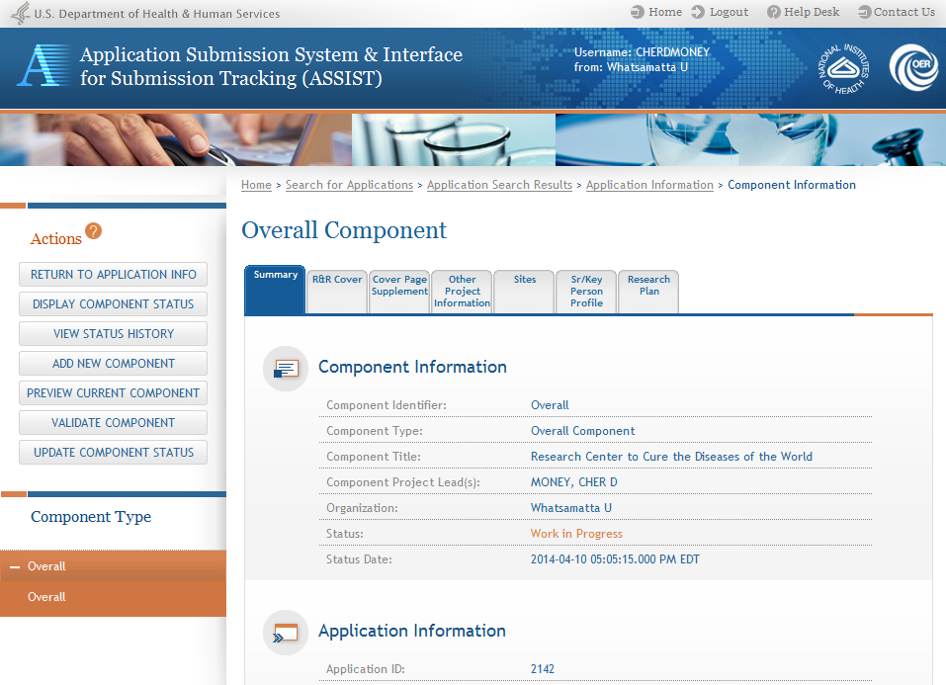
Overall Component
Required forms are presented for the component.
The Overall Component is added to the component navigation.

Slide 33
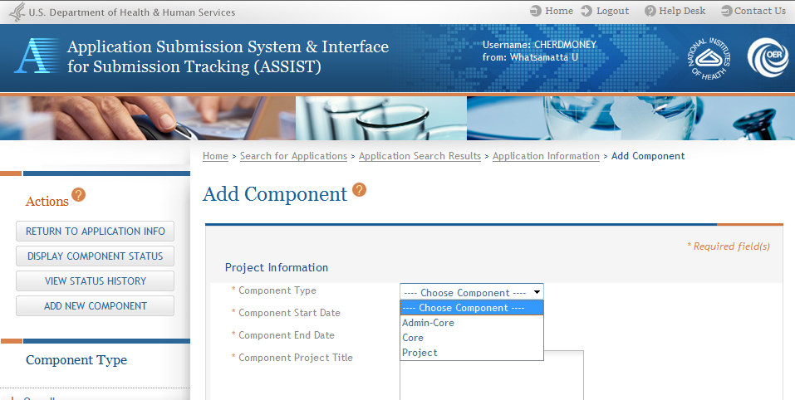
Adding Additional Components
Add additional components.
Applicants are presented with allowable component types as defined in the FOA.

Slide 34
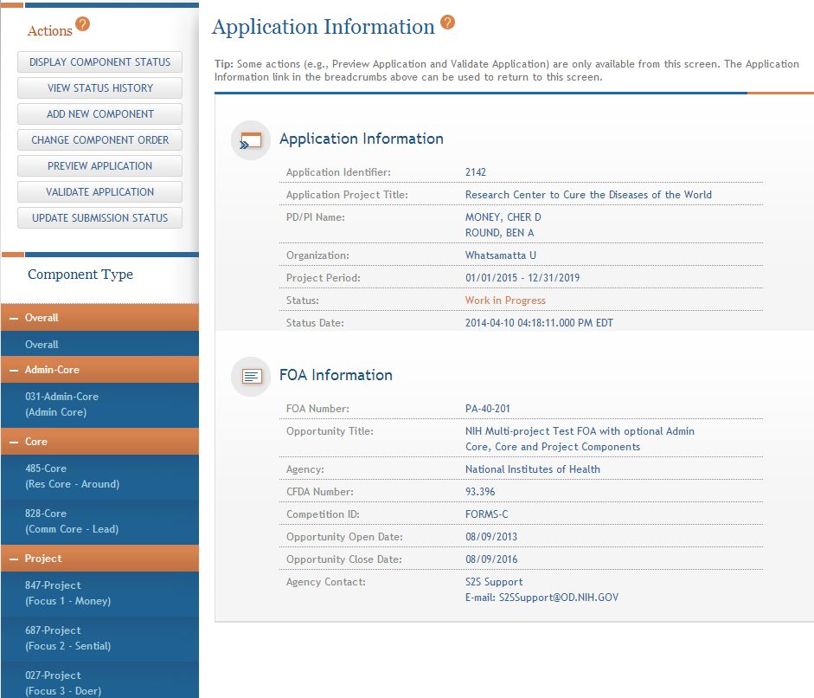
Adding Components
Continue adding components to build out the application shell.

Slide 35
Define Your Team and Provide Application Access
Find
Plan
Initiate
Build Team
Enter Data
Finalize
Submit
Track

Slide 36
Automatic Application Access
ASSIST automatically provides application access to some individuals based on their Commons roles or role on the application
  The person that initiates the application has edit access for the entire application
  All SOs and AOs at the applicant institution have irrevocable edit access for the entire application
  All PD/PIs listed on the Overall application have edit access for the entire application
  All SOs and AOs at an organization leading a component have irrevocable edit access for their component
  The component Project Leads have edit access for their components

Slide 37

Managing Access
Application access can be given to additional users with Commons IDs
  Within or outside applicant organization
Application access can be controlled across these variables:
  Entire application vs. specific components
  Read vs. Edit
  Budget vs. Non-budget data

Slide 38

Signing Officials (SOs)
SOs at the applicant institution can
  Manage application access for other users
  Manage application status all the way to Ready for Submission status
  Delegate Access Maintainer
  and Status Maintainer authority
  to other users within their
  institution
  Access the Submit action

Slide 39
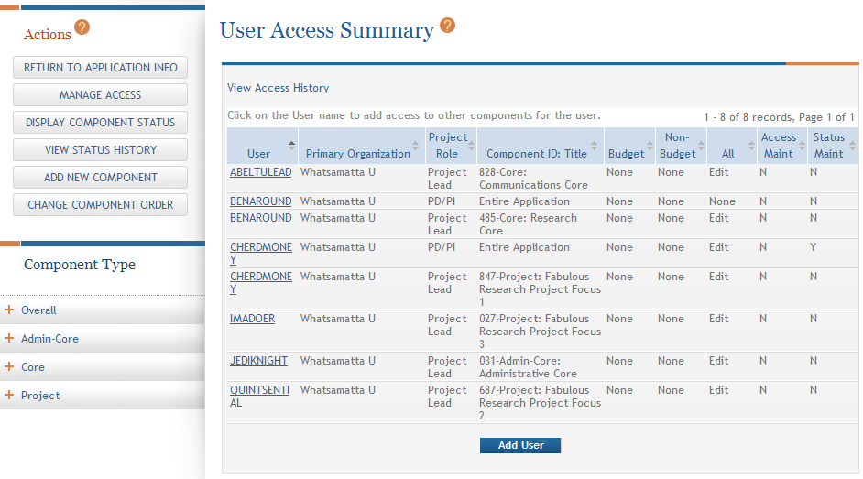
Managing Access
The Manage Access action can be used to provide access to additional users or modify access for existing users.

Slide 40
Enter Application Data
Find
Plan
Initiate
Build Team
Enter Data
Finalize
Submit
Track

Slide 41
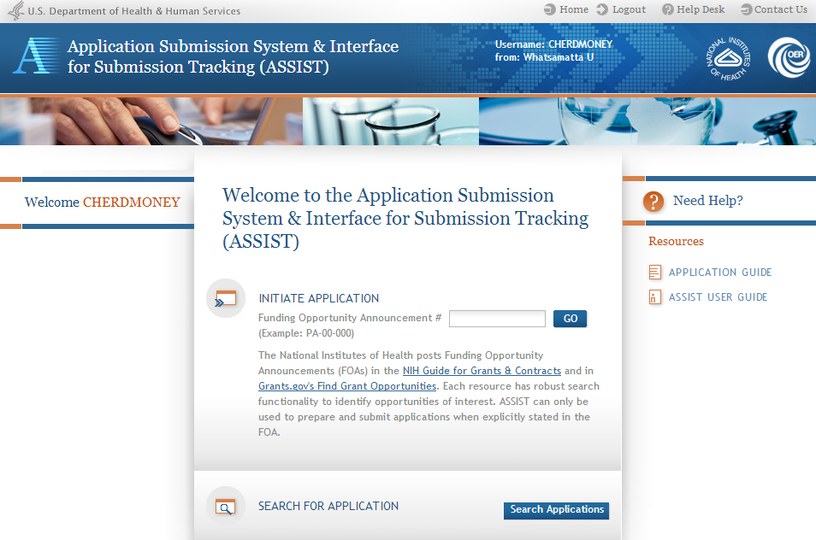
Searching for In-progress Applications
Use Search Applications to access your in progress application.

Slide 42
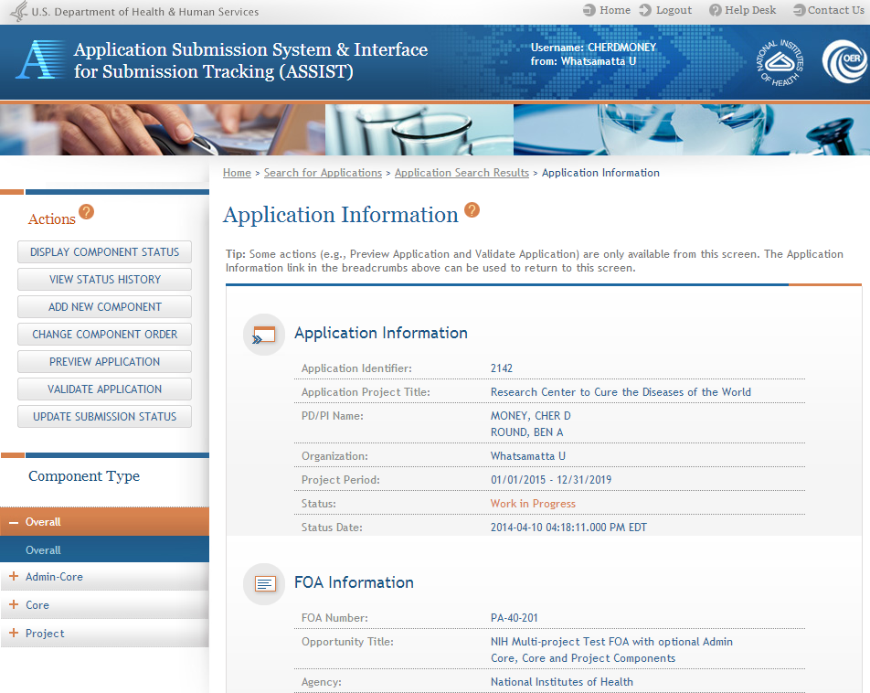
Navigating to a Specific Component
Use the component navigation to identify the component you want to work on.

Slide 43
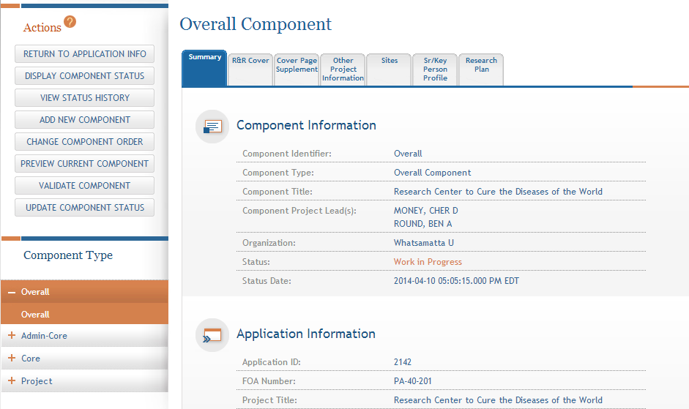
Summary Page
Every component has a Summary page.
Some actions are only available from the Summary page.

Slide 44
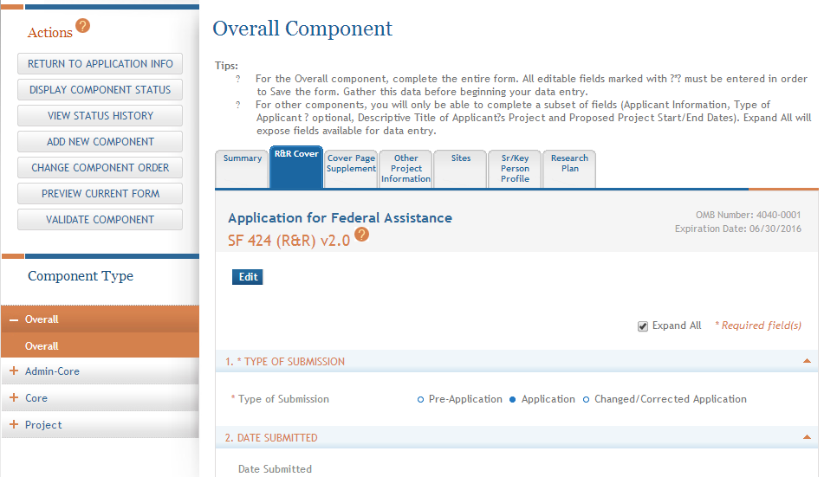
Entering Application Data
Click each tab to access form data entry screens.
Clicking Edit blocks other users from editing form.

Slide 45
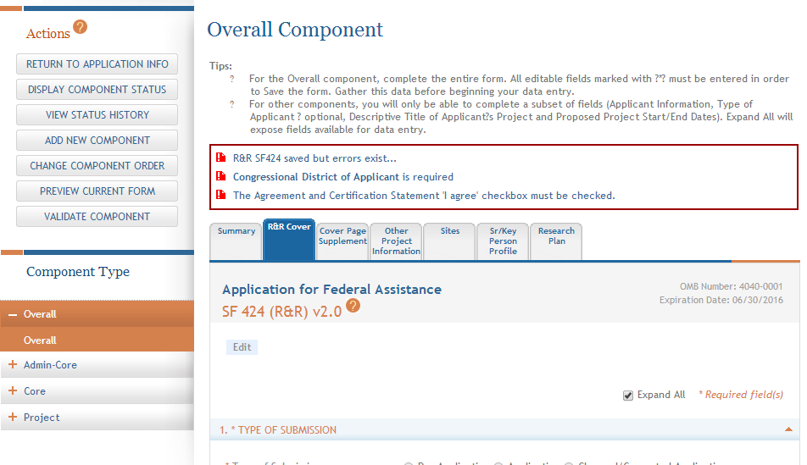
Data Entry Validation
ASSIST will validate entered data and provide errors at the top of the screen when you Save.

Slide 46
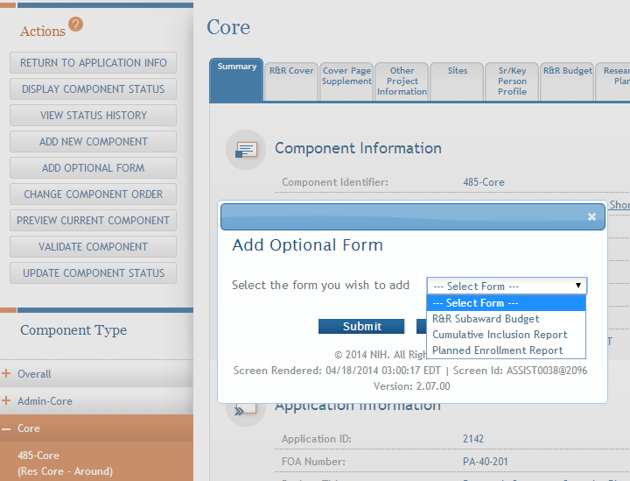
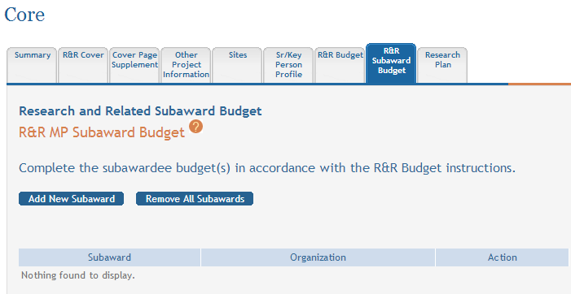
Adding Optional Forms
Select form and click Submit.
The form tab is added to navigation.

Slide 47
Data Entry: R&R Cover
Overall | All other components
All form fields used | Subset of fields used: Field 5: Organization Information Field 7 (Optional): Type of Applicant Field 11: Descriptive Title of Applicant’s Project Field 12: Proposed Project Start/End Dates

Slide 48
Data Entry: Other Project Information
Overall Component | All other components
Human Subjects: Standard Application Guide instructions apply | Human Subjects: Answer only the ‘Are Human Subjects Involved?’ and Is the Project Exempt from Federal regulations?’ questions.
Vertebrate Animals: Standard Application Guide instructions apply | Vertebrate Animals: Answer only the ‘Are Vertebrate Animals Used?’ question.
Project Narrative: Used by NIH for statement of public health relevance; required | Project Narrative: FOA may specify attachment is optional.

Slide 49
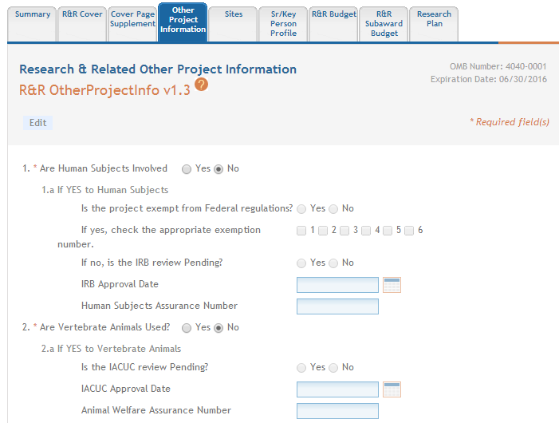
Data Entry: Other Project Information
ASSIST prevents data entry of additional Human Subject and Vertebrate Animal info on components other than Overall.

Slide 50
Data Entry: Research Plan
Overall Component | All other components
Attachments: Describe the entire application. | Attachments: Reflect the activity in the specific component.
Introduction: Required for Resubmission/ Revision applications | Introduction: See FOA instructions.
Specific Aims: Required | Specific Aims: Required
Research Strategy: See FOA instructions for page limit. | Research Strategy: See FOA instructions for page limit.

Slide 51
Data Entry: Sr/Key Person Profile
Overall Component | All other components
Use the Project Director/Principal Investigator section to designate the Contact PD/PI Include any Multi-PD/PIs Project Role of PD/PI | Use the Project Director/Principal Investigator section to designate the Project Lead Must not use PD/PI role ASSIST defaults role to Other, Project Lead Follow FOA instructions
Applications must include a single biosketch for each Sr/Key person regardless of the number of components they are listed on. Biosketch can be included with any entry – just pick one.

Slide 52
Avoid Common Errors
ASSIST screen tips
  Found at the top of many data entry screens
Application Guide
Annotated form sets
  http://grants.nih.gov/grants/ElectronicReceipt/communication.htm#forms
Ten Checks to Help Avoid Common Errors
  http://grants.nih.gov/grants/ElectronicReceipt/avoiding_errors.htm#10checks

Slide 53
Component Actions
As component data is entered several actions are available:
  Change Component Order
  Validate Component
  Preview Current Component
  Update Component Status
    Work In Progress – only status that allows editing
    Complete – component data entry is complete
    Final – component has been reviewed by applicant organization and incorporated into the application

Slide 54
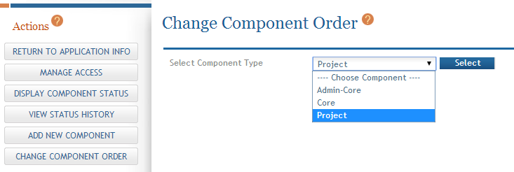
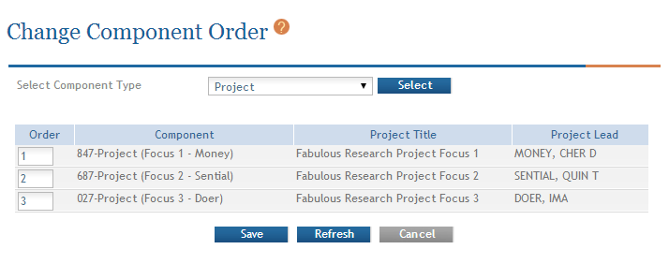
Change Component Order
Select Component Type to reorder.
Provide desired sequence.

Slide 55
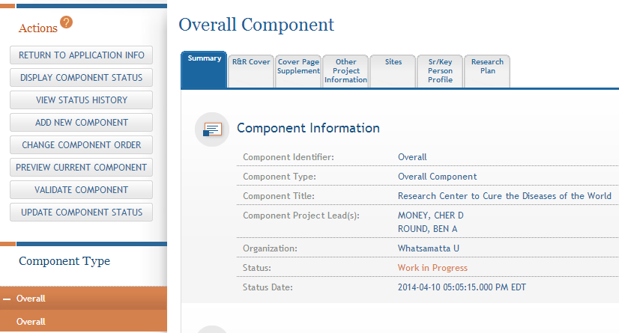
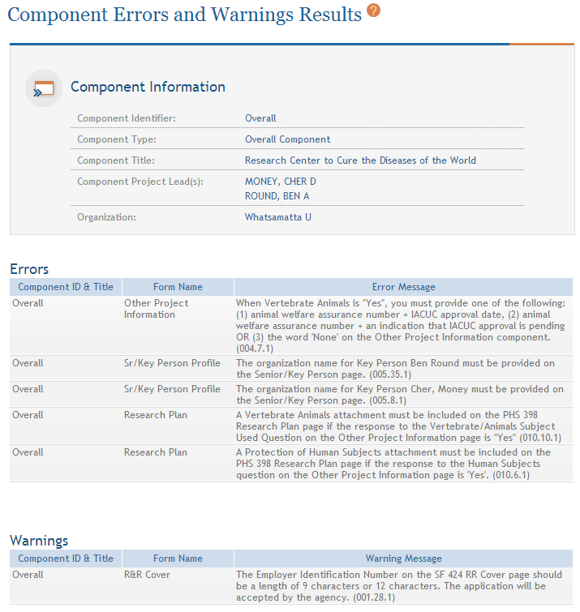
Validating a Component
Errors and Warnings are displayed.

Slide 56


Errors & Warnings
Errors stop application submission and processing and must be corrected before the deadline
Warnings do not stop application submission or processing and are corrected at the discretion of the applicant before the deadline

Slide 57
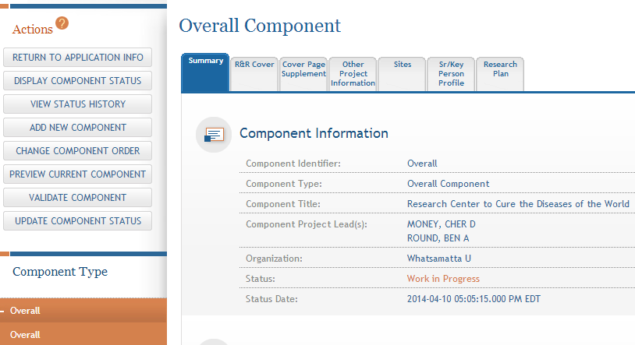
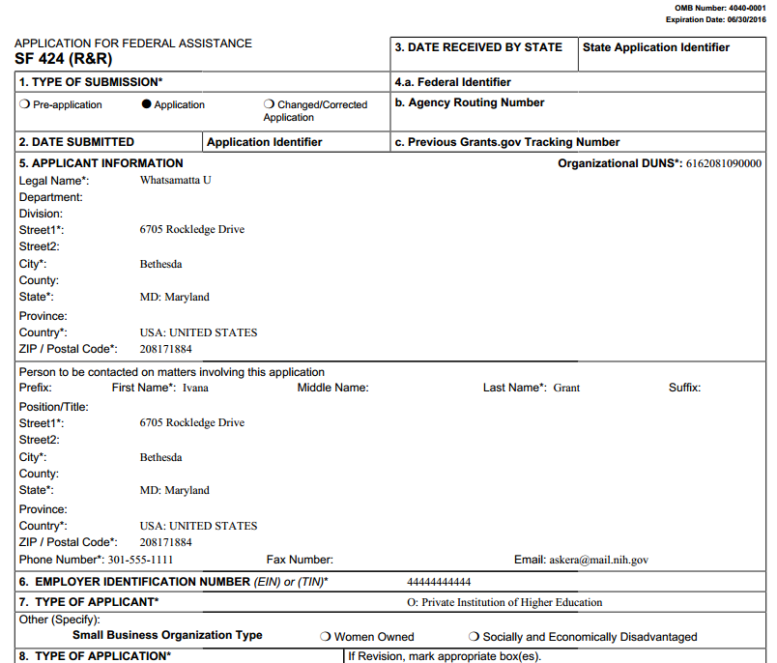
Previewing a Component
Component preview does not include bookmarks, Table of Contents, data summaries or biosketches.

Slide 58
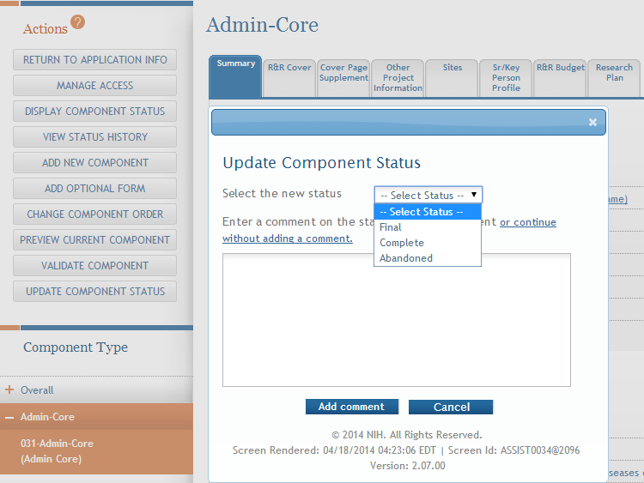
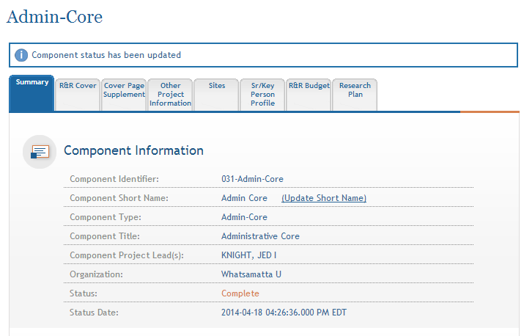
Updating Component Status to Complete
Select status and enter comment for Status History.
Once a component is marked ‘Complete’ no additional edits can be made unless someone with entire application edit authority returns the status to ‘Work in Progress’.
Status on Summary page is updated.

Slide 59

Finalize Content & Prepare Your Application for Submission
Find
Plan
Initiate
Build Team
Enter Data
Finalize
Submit
Track

Slide 60
Finalizing Components
As components are marked ‘Complete’, the applicant organization can preview them and incorporate those that are ready into the final application by updating the component status to ‘Final’.
All components must be marked ‘Final’ before an application can be prepared for submission.

Slide 61
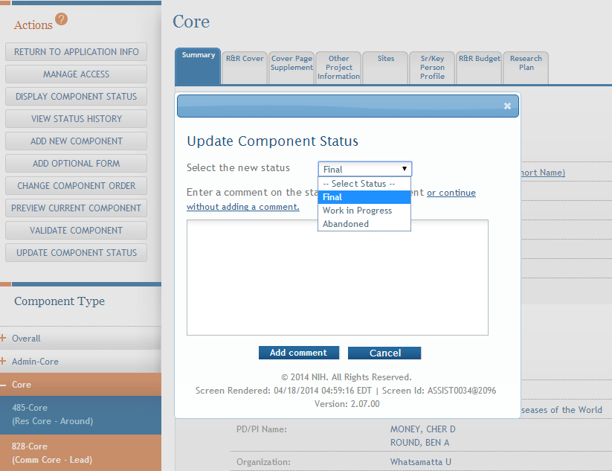
Finalizing Components
Update the component status to Final once you are satisfied that the component is ready to be included in the final application.

Slide 62
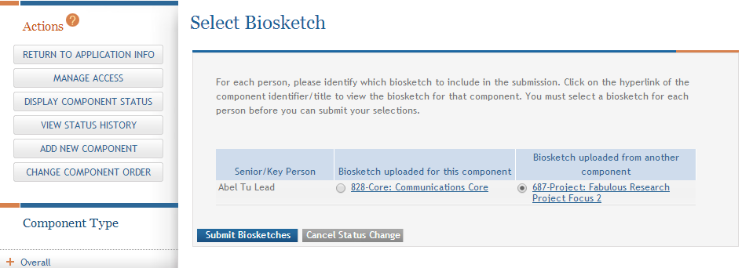
Finalizing Components
ASSIST will check to ensure that only one biosketch is included for every Senior/Key person in the application.
If a biosketch is already included for any Sr/Key, you will have the option to view each biosketch and select the one you wish to keep.

Slide 63
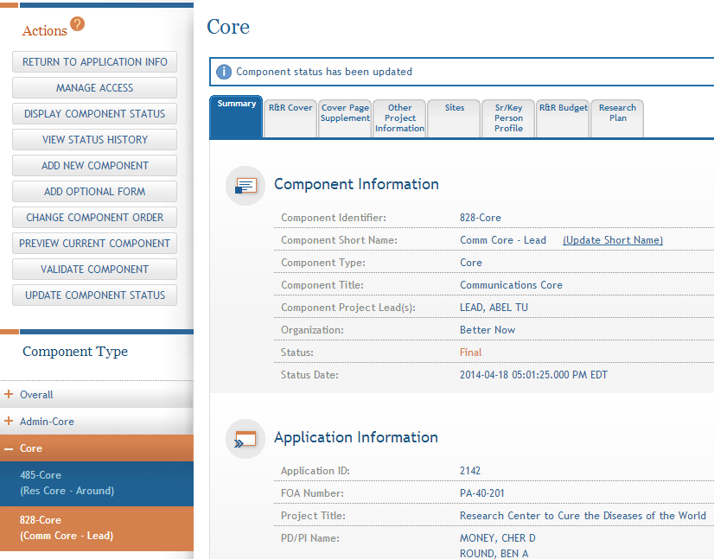
Finalizing Components
  After all biosketch issues are reconciled, the component status is set to Final.

Slide 64
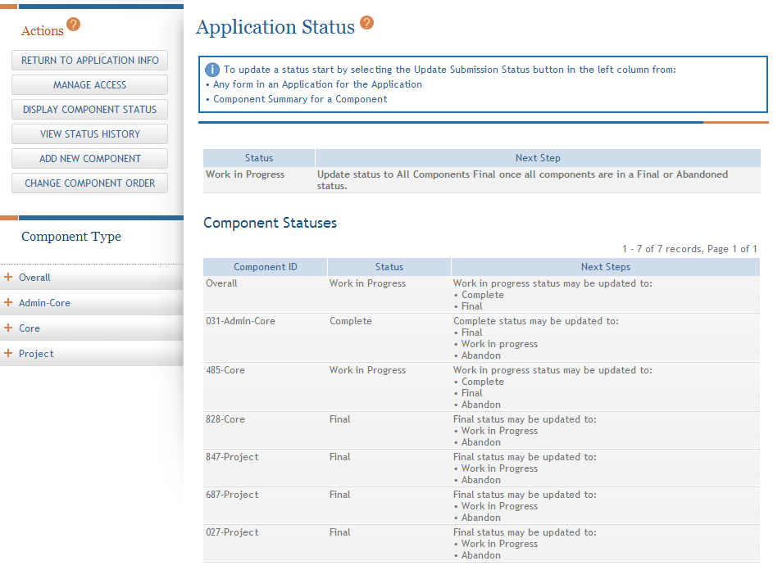
Display Component Status
  Provides all application and component status on a single screen.

Slide 65
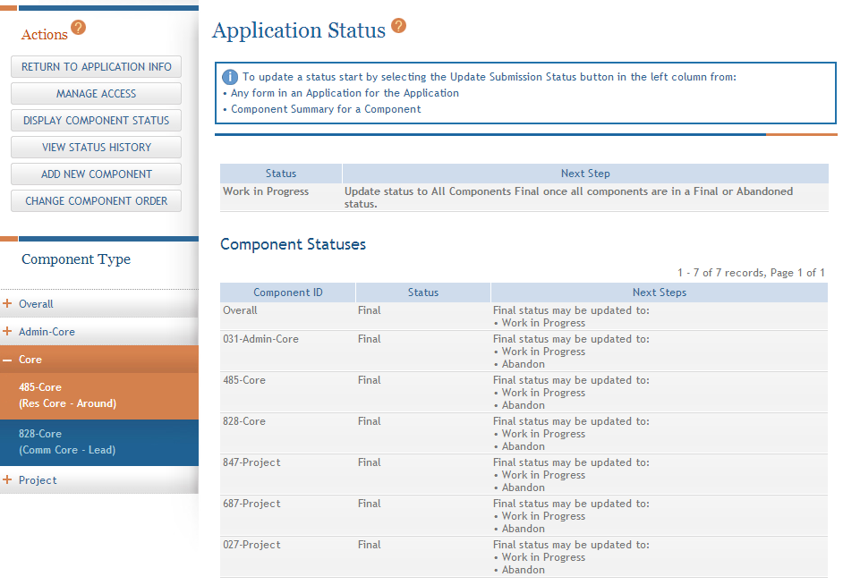
Updating Application Status
Although the Status is set to Final for each component, the Application Information still shows a Status of Work in Progress.

Slide 66
Application Status Flow
Work In Progress – Allows editing
All Components Final – Can only be updated once each component status is Final; must Validate Application to move to next status
All Components Validated – Automatically set once Application Validation is error-free
Ready for Submission – Should be set after all internal reviews have taken place
Submitted – Automatically set after submitting to Grants.gov

Slide 67
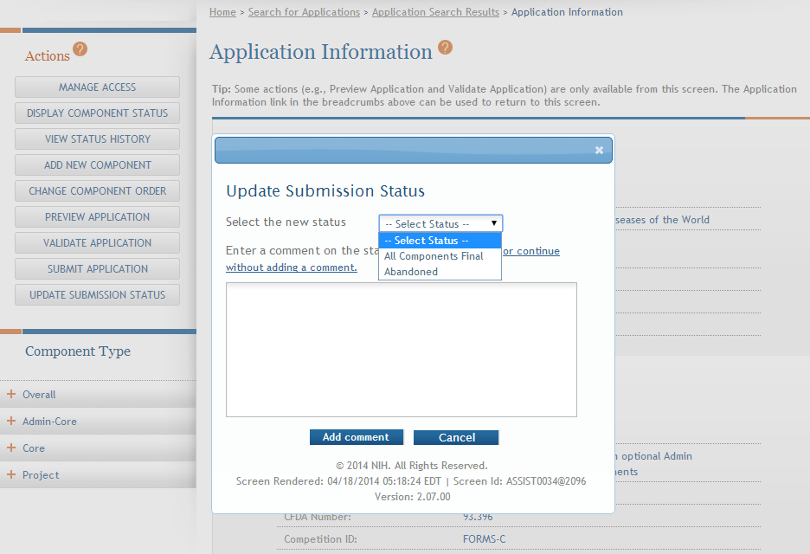
All Components Final
You can prepare your application for submission once the status for all individual components has been set to Final.
Set the application status to All Components Final.

Slide 68
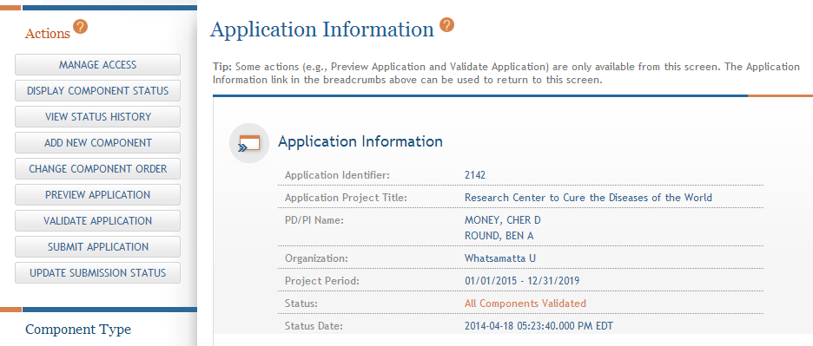
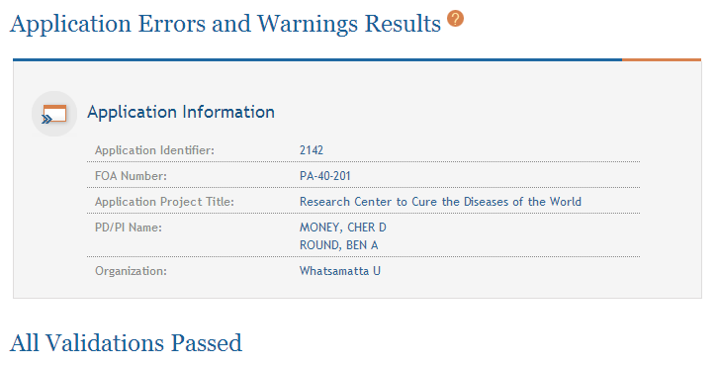
Final Validation Check
Before an application can be submitted, it must pass validations (Warnings are OK).

Slide 69
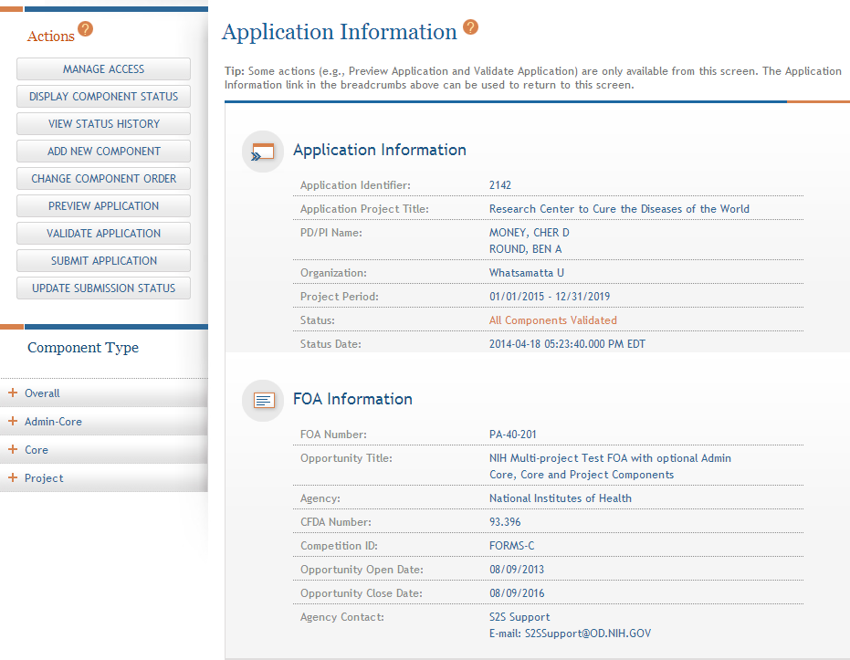
All Components Validated
When the application passes validations, the application status is automatically updated to All Components Validated.

Slide 70
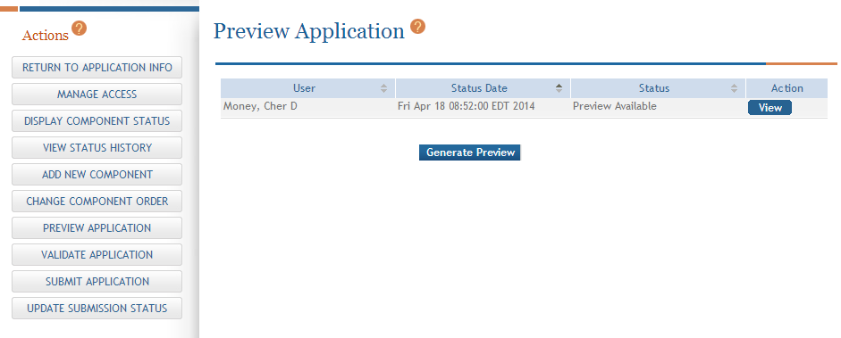
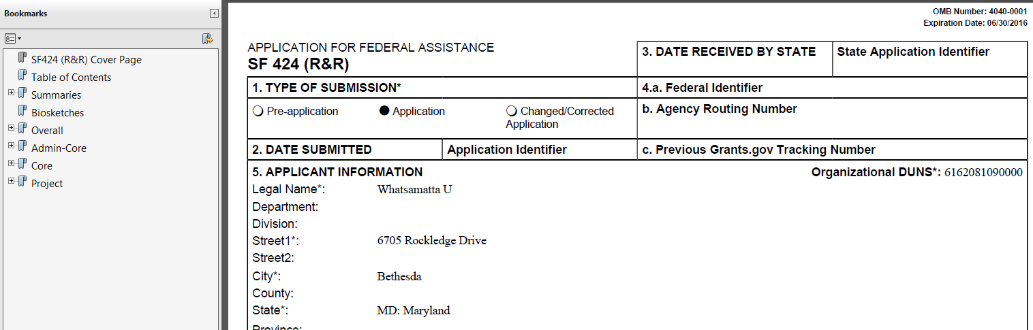
Preview Application
Before you submit you can Preview the Application and verify that everything is just the way you want it to go to review.

Slide 71
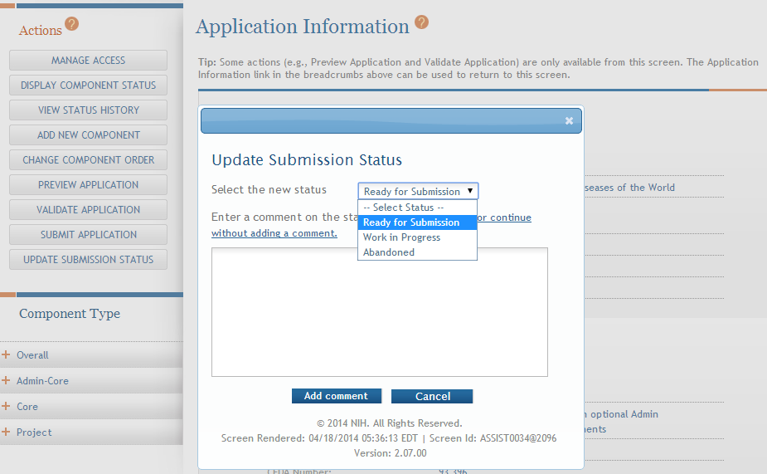
Ready for Submission
Once all internal reviews are complete, update the application status to Ready for Submission.

Slide 72
Submit Your Application
Find
Plan
Initiate
Build Team
Enter Data
Finalize
Submit
Track

Slide 73

On-time Submission
Error-free submission must be made by 5:00 p.m. local time (of submitting organization) on due date
  It takes time to prepare your application for submission
  Submit early (days, not minutes)
  to have time to address any
  unforeseen issues and to view
  your assembled application

Slide 74
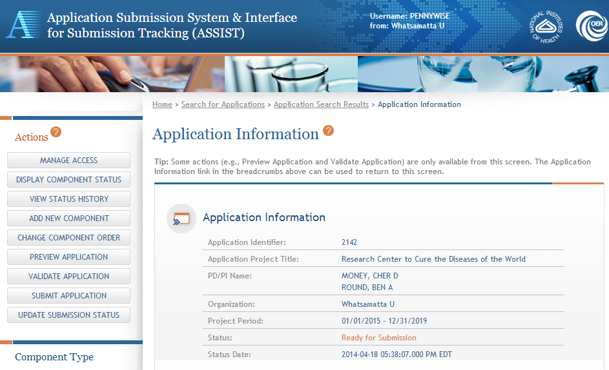
Submit Your Application
Must be a Signing Official (SO) for the Lead Organization who is an Authorized Organizational Representative (AOR) to submit.
Application Status must be set to Ready for Submission.

Slide 75
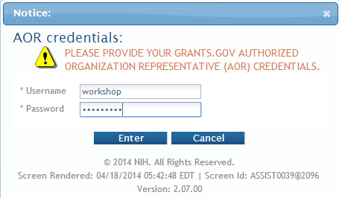
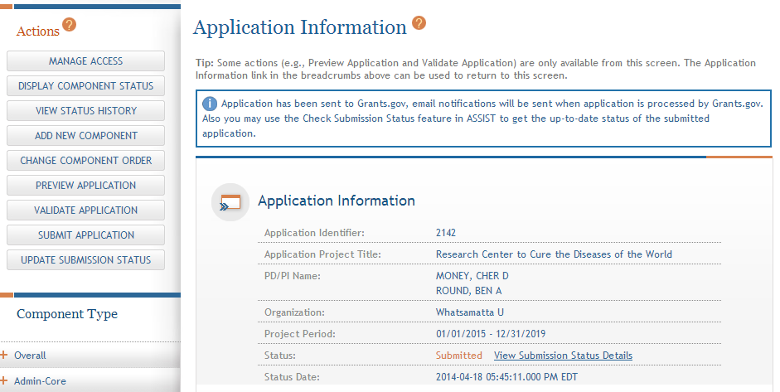
Submit Your Application
Applications are submitted from ASSIST to Grants.gov.
Enter your Grants.gov AOR credentials and click Enter.
Message will appear indicating the application was sent to Grants.gov.

Slide 76
Track Your Application
Find
Plan
Initiate
Build Team
Enter Data
Finalize
Submit
Track

Slide 77

Notifications
ASSIST sends out quite a few email notifications throughout the preparation
and submission process to help you
track your application
  Application access changes, component/application updates, component/application status changes, submission status updates and more
  Notifications being reviewed to determine if they should be kept, consolidated or removed
Check out this resource: http://grants.nih.gov/grants/electronicreceipt/files/ASSIST_eNotifications.pdf

Slide 78

Tracking Submission Status - ASSIST
ASSIST provides the ability to track both Grants.gov and NIH status
  ASSIST provides a link to the Commons Detailed Status Information to view your assembled application

Slide 79
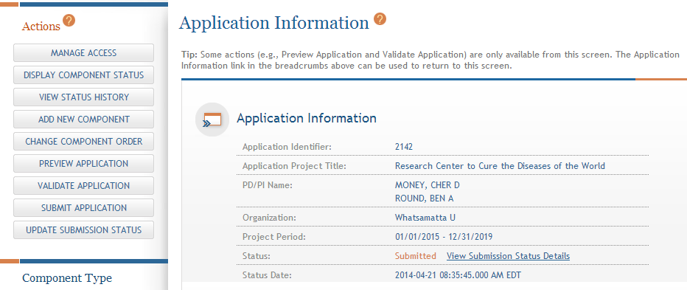
Tracking Submission Status - ASSIST
After submitting to Grants.gov, submission status can be tracked in ASSIST.
Click View Submission Status Details.

Slide 80
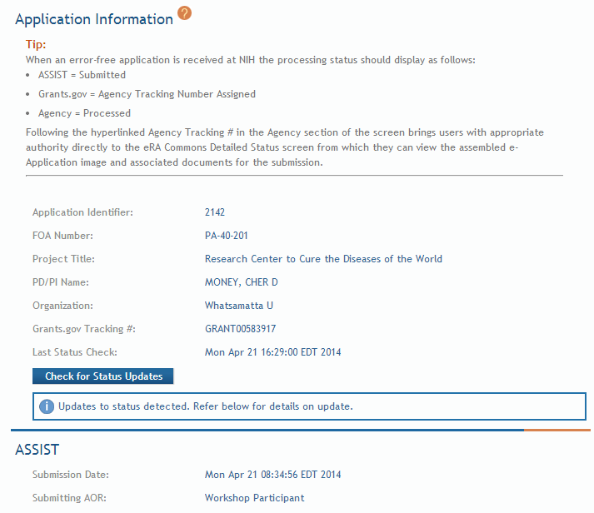
Tracking Submission Status - ASSIST
Top of screen
You must click Check for Status Updates to force ASSIST to poll Grants.gov and NIH for status.
ASSIST will indicate if a status change was detected.

Slide 81
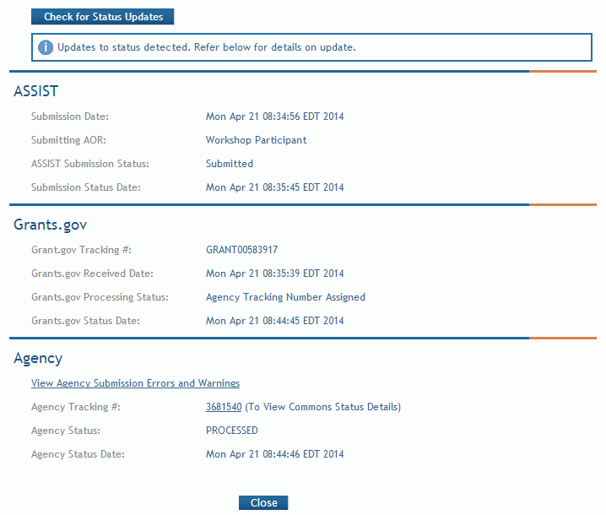
Tracking Submission Status - ASSIST
ASSIST, Grants.gov and Agency submission status are available.
Grants.gov status of Agency Tracking Number Assigned and Agency status of Processed is good news!
Agency Tracking # link brings you to the detailed status screen in eRA Commons.

Slide 82

Viewing Your Application in Commons
eApplication is the application image reviewers will use so check it carefully.
You will also want to check the Cover Letter and Component Appendices which are stored separate from the image.

Slide 83

Application Viewing Window
Applicants have two (2) business days to view the assembled application image in Commons before it automatically moves forward to NIH staff for further processing
If you can’t VIEW it, we can’t REVIEW it!

Slide 84

Viewing Your Application in Commons
It is your responsibility to carefully review the entire
application to ensure it has been processed correctly!

Slide 85




Automatic Data Summaries

Slide 86

Automatic Data Summaries

Slide 87


Automatic Data Summaries

Slide 88

Rejecting the Application
SO can Reject application in Commons within viewing window and submit a Changed/Corrected application prior to the due date

Slide 89

Submission Complete!
If no action is taken to reject the application during the two business day viewing window, the application automatically moves forward to NIH for further processing.

Slide 90

Some Final Notes…
Be patient when Validating or Previewing a Component or Application and resist the urge to click the action button again and again. It will only increase the time to complete the action.
  Submitting again without doing a Changed/Corrected application can cause a ‘duplicate’ error

Slide 91

Dealing with System Issues
Applicants should follow NIH’s standard ‘system issue’ procedure if they run into problems beyond their control that threaten their on-time submission: http://grants.nih.gov/grants/ElectronicReceipt/support.htm#guidelines

Slide 92

ASSISTance

Slide 93


On-line ASSIST Help
Help opens in a separate window at the location requested.
Click on question mark icon to access ASSIST help.
Search feature.
Help on form data entry screens provides access to Application Guide for additional guidance on field content information.

Slide 94

Links & Resources
ASSIST: public.era.nih.gov/assist
Online help: era.nih.gov/erahelp/ASSIST/
Applying Electronically Website for Multi-project Applications: grants.nih.gov/grants/ElectronicReceipt/com_index.htm
Webinar for Applicants:
  http://grants.nih.gov/grants/webinar_docs/webinar_20130813.htm
Annotated form set: grants.nih.gov/grants/ElectronicReceipt/files/annotated_multi-project.pdf

Slide 95

Help Desk
eRA Commons Help Desk
Web: http://era.nih.gov/help/
Toll-free: 1-866-504-9552
Phone: 301-402-7469
Hours: Mon-Fri, 7a.m. to 8 p.m. Eastern Time
(Except for Federal holidays)
Although we’ve worked closely with Grants.gov, ASSIST is a system developed and managed by NIH.
The eRA Commons Help Desk should be an applicant’s first stop for support.

Slide 96

Feedback
We welcome continued feedback to help with a smooth transition to e-applications.
Unfortunately, we can’t add as many bells and whistles as we might like, but we really want to know what is needed.
Have suggestions? Let us know through the eRA Help Desk web ticketing system
    https://public.era.nih.gov/commonshelp
    Choose ‘Other’ for the ‘I need help with question’
    Start your Description with ‘ASSIST Feedback’

Slide 97







Questions
Q
S
S
I
U
E
T
O
N

